Slide 1

AI Chatbot For Education

Slide 2
Contents
Project overview and Scope
Project Goals
CRISP-ML(Q) Methodology
Technical Stacks
Project Architecture
Chatbot
Natural Language Understanding
Data Understanding
Data Preparation
Model Selection and Building
Model Evaluation
Output
Model Deployment
Conclusion
Future Scope

Slide 3
Project Overview and Scope
Technology today is evolving at breakneck speeds, offering businesses multiple opportunities to market their brands and enhance the customer experience.
This project aims to increase customer experience by giving customer control to get their query answered at any point of time.
This project is about creating a chat bot in which it will answers queries to related to data science, machine learning and AI.
Chatbots are expected to be used by 47 percent of firms for customer service, and virtual assistants by 40 percent, suggesting that by the end of 2022.
Building specified conversation trees are key to your chatbots perception as a communication enhancer between customers and your business.

Slide 4
Project Goals
Objectives
Constraints
Business Problem: To create a chatbot related to data science , machine learning and AI.
Maximize - Customer experience
Minimize - Invalid answers and time required.
Chatbots can only handle basic Questions.
Creation of large dataset
It require constant maintenance.

Slide 5
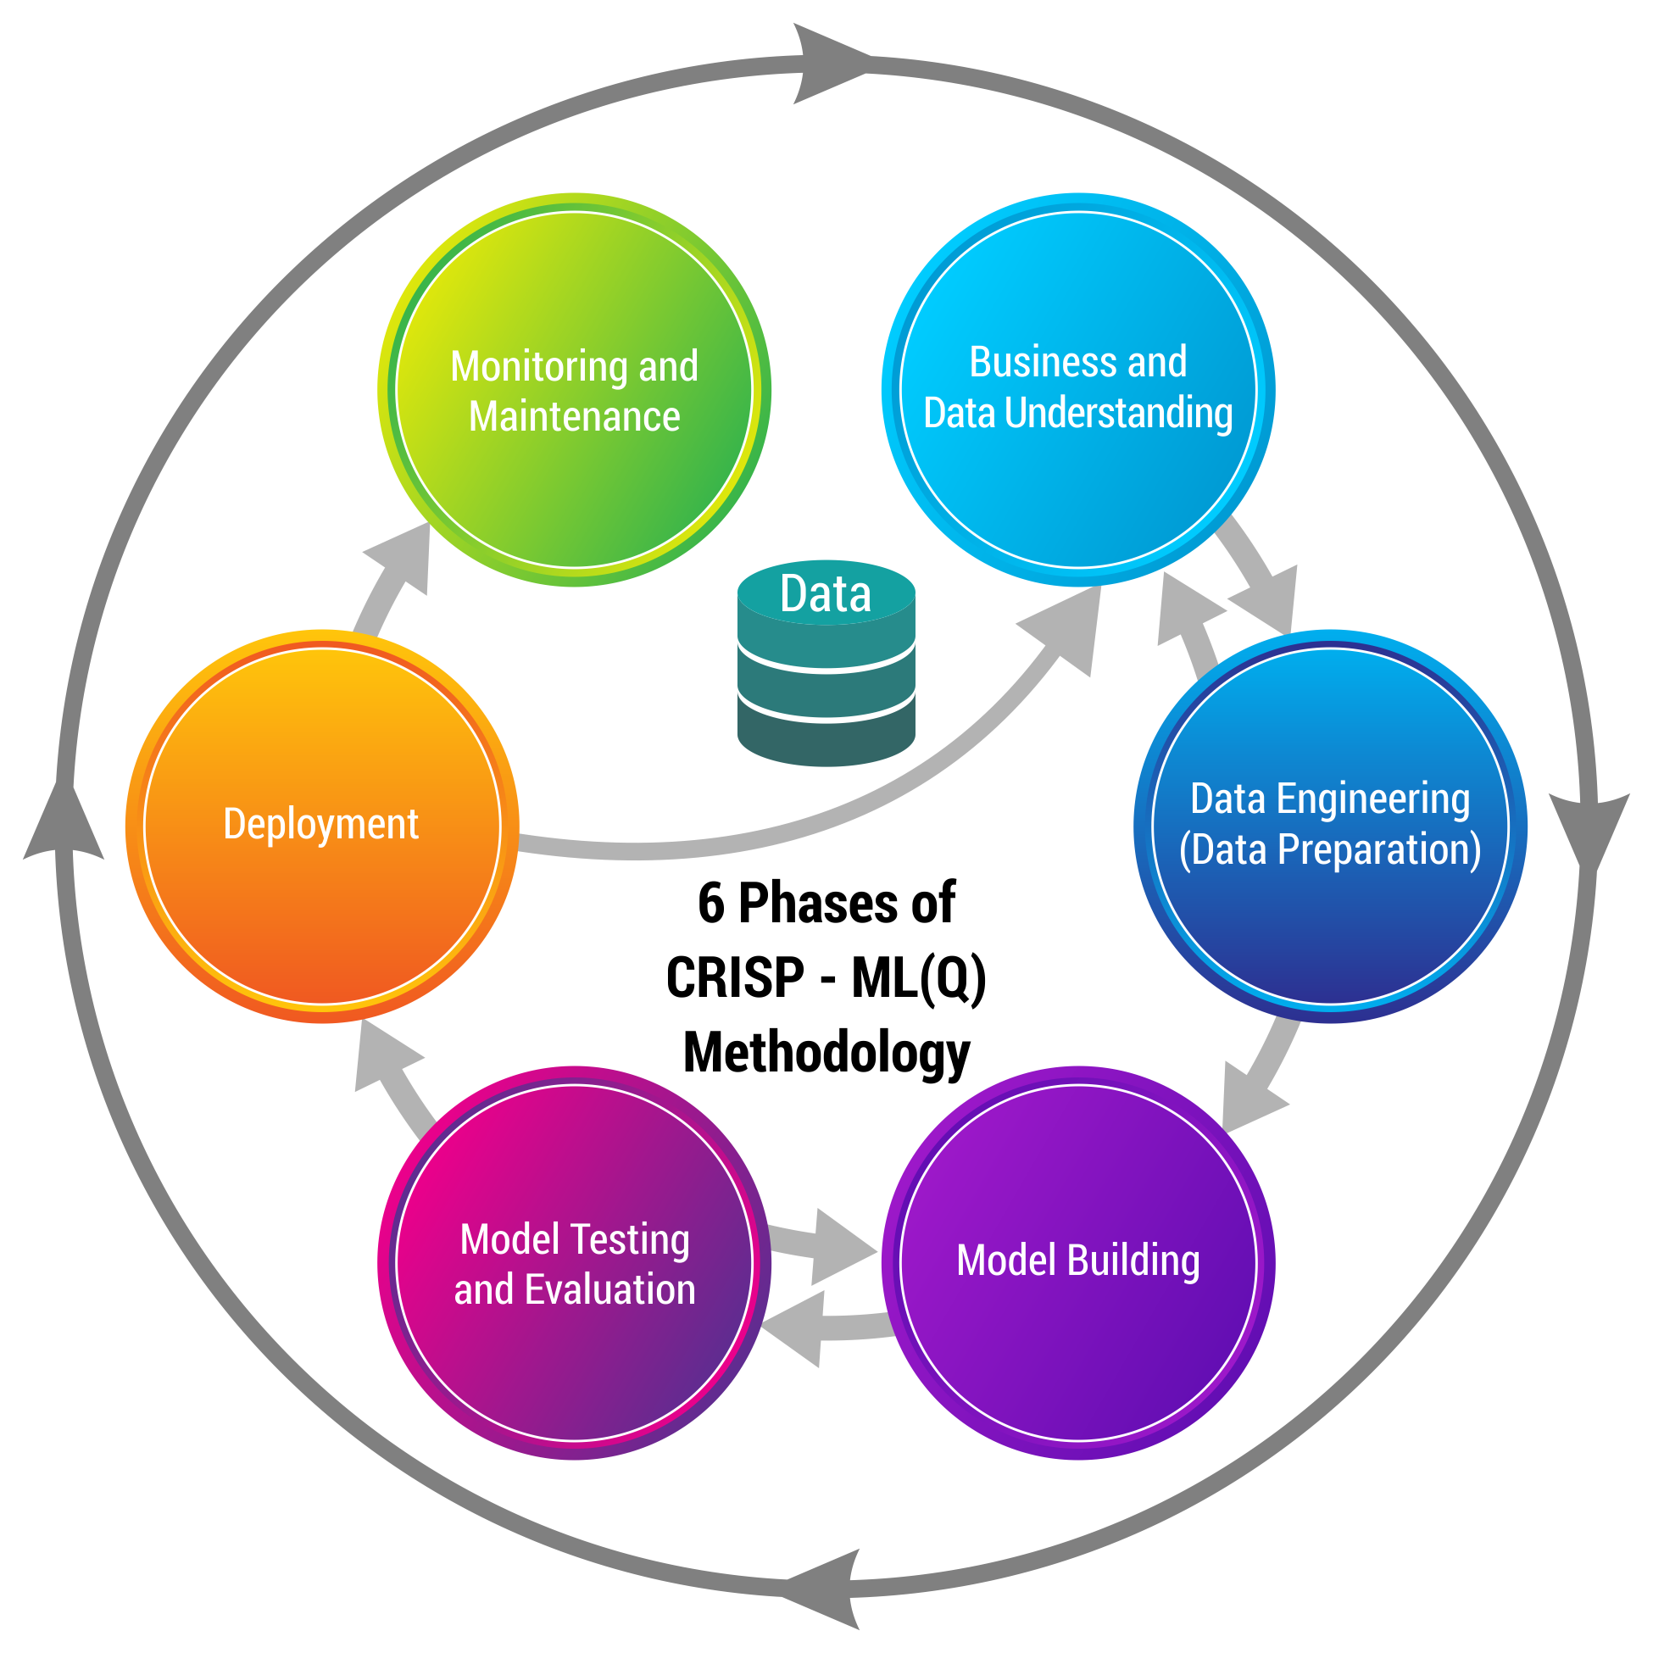
CRISP-ML(Q) Methodology

Slide 6
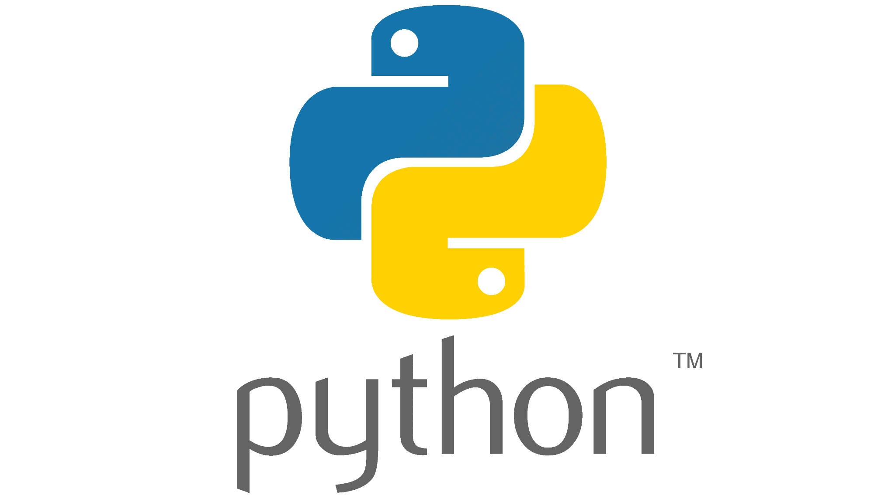









Technical Stacks

Slide 7

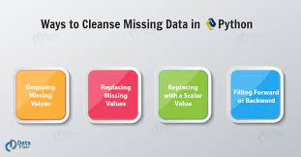
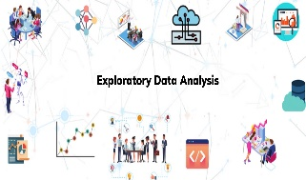

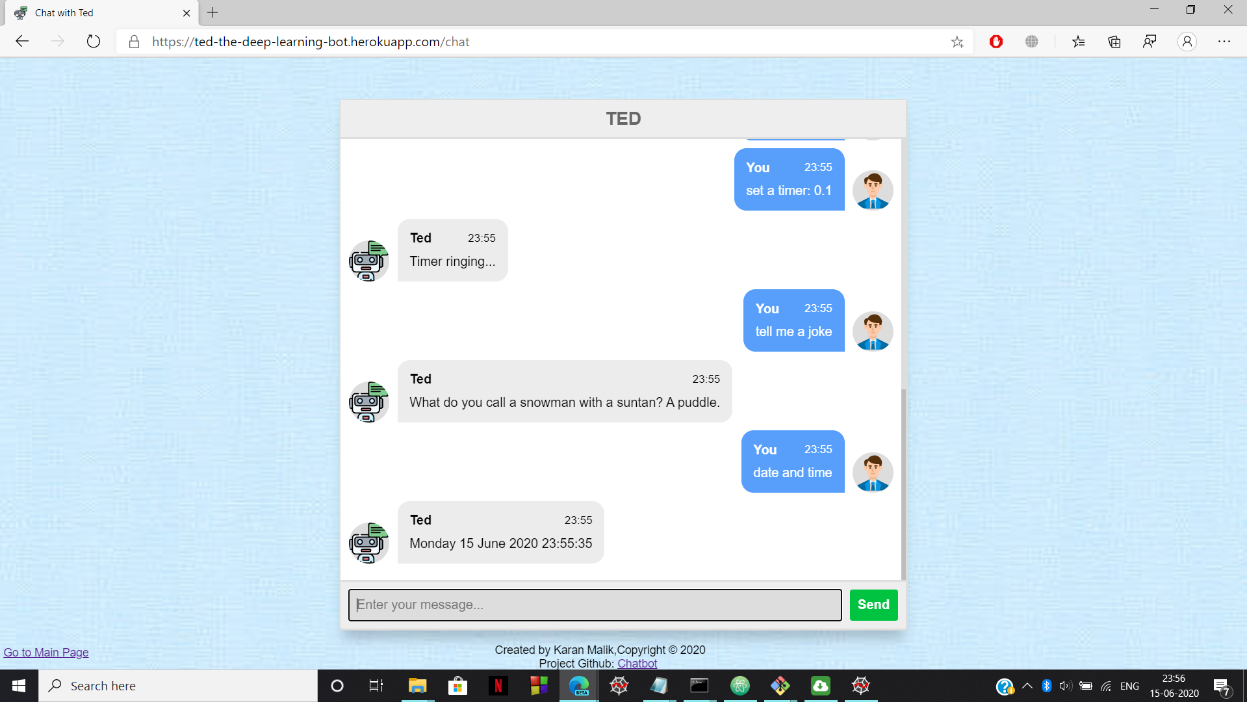

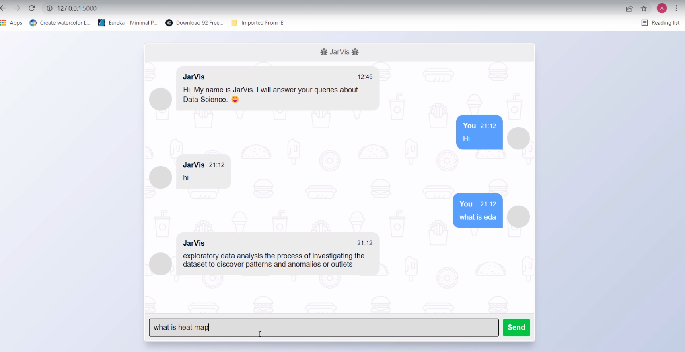
Project Architecture
Data collection
Data Preparation
Model Building
Model Evaluation
Model Deployment

Slide 8
Chatbot
A chatbot is a computer program that simulates human conversation through voice commands or text chats or both.
This tool helps add convenience for customers-they are automated programs that interact with customers like a human would and cost little to nothing to engage with.
In its simplest form, chatbots can be programmed to answer specific, frequently asked questions, offering an easy way to engage with visitors.
In a rule-based approach, a bot answers questions based on some rules on which it is trained on. The rules defined can be very simple to very complex. The creation of these bots are relatively straightforward using some rule-based approach, but the bot is not efficient in answering questions, whose pattern does not match with the rules on which the bot is trained.

Slide 9
NATURAL LANGUAGE PROCESSING (NLP)
NLP
Natural language processing (NLP) is a field that focuses on making natural human language usable by computer programs. NLTK, or Natural Language Toolkit, is a Python package that you can use for NLP.
Natural language Processing (NLP) is a subfield of artificial intelligence, that involves the interactions between computers and humans.
In modern days, most of our smartphones have a speech recognition system. These smartphones use NLP to understand the natural language and give the response.

Slide 10

Data Collection
Data was gathered manually
Each team member was given a particular topic related to data science on which they made possible questions and answer related to the topic.
Then, every individual created a JSON file containing questions and answer of their given topics.
Finally, we merged all the JSON file and generated as corpus containing all questions and answers.

Slide 11
DATA PRE-PROCESSING
Re Module
A regular expression (or RE) specifies a set of strings that matches it; the functions in this module let you check if a particular string matches a given regular expression (or if a given regular expression matches a particular string, which comes down to the same thing).
Tokenization
Tokenization is the process of tokenizing or splitting a string, text into a list of tokens. One can think of token as parts like a word is a token in a sentence, and a sentence is a token in a paragraph.
Stop words
A stop word is a commonly used word (such as “the”, “a”, “an”, “in”) that a search engine has been programmed to ignore, both when indexing entries for searching and when retrieving them as the result of a search query.

Slide 12
DATA PRE-PROCESSING
Remove unwanted character using regular expression
Auto correct the dataset
Tokenize question data
Stop word removal of question data
Lemmatize the question data

Slide 13
Model Selection
TF-IDF Vectorizer
TF-IDF stands for Term Frequency Inverse Document Frequency of records. It can be defined as the calculation of how relevant a word in a series or corpus is to a text. The meaning increases proportionally to the number of times in the text a word appears but is compensated by the word frequency in the corpus (dataset).
Cosine Similarity
Cosine similarity is a measure of similarity between two non-zero vectors of an inner product space that measures the cosine of the angle between them. Similarity = (A.B) / (||A||.||B||) where A and B are vectors.

Slide 14
Model Building
The model is TF-IDF Vectorizer based on Machine Learning.
TF-IDF Vectorizer convert the texts into matrix.
Matrix is of n*n, where n is number of questions presents in corpus.
Matrix contains the distances between the questions like, how a question is different from other questions present in corpus.
If a user enter a question, the function is going to measure the similarity between the input question and the question present in corpus.
If cosine similarity of the user’s question and a particular question in corpus is greater than 0.5 than it is going to return the answer to that question.

Slide 15
Model Evaluation
We checked our model accuracy on training data itself and we found out that, for different value of cosine similarity we got different accuracy.
For Example – If we set cosine similarity smaller than 0.5 then we got an accuracy around 81%, while for greater than 0.6 cosine similarity value we got 76% accuracy.
So, We applied Grid Search and we got our threshold value.

Slide 16
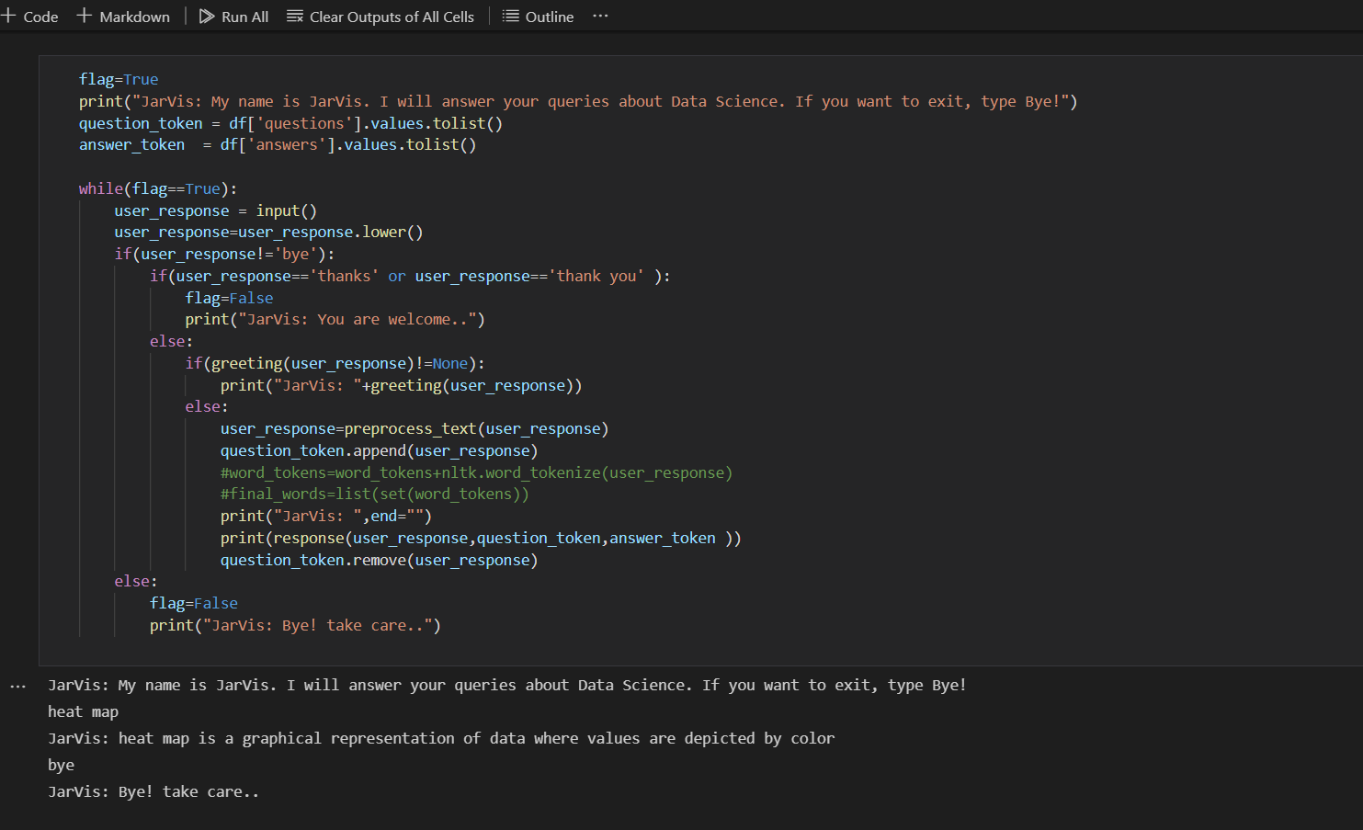
Output

Slide 17
Model Deployment
Flask framework was used for deployment.
Flask is a micro web framework written in Python. It is classified as a micro framework because it does not require particular tools or libraries.
Defined two routes, one for rendering the templates and other for getting the response corresponding to it.
Firstly, initialized the app and defined the routes. Later, defined helper function for responding to the queries from the user.
Used JavaScript to display the response from flask API to user view.

Slide 18
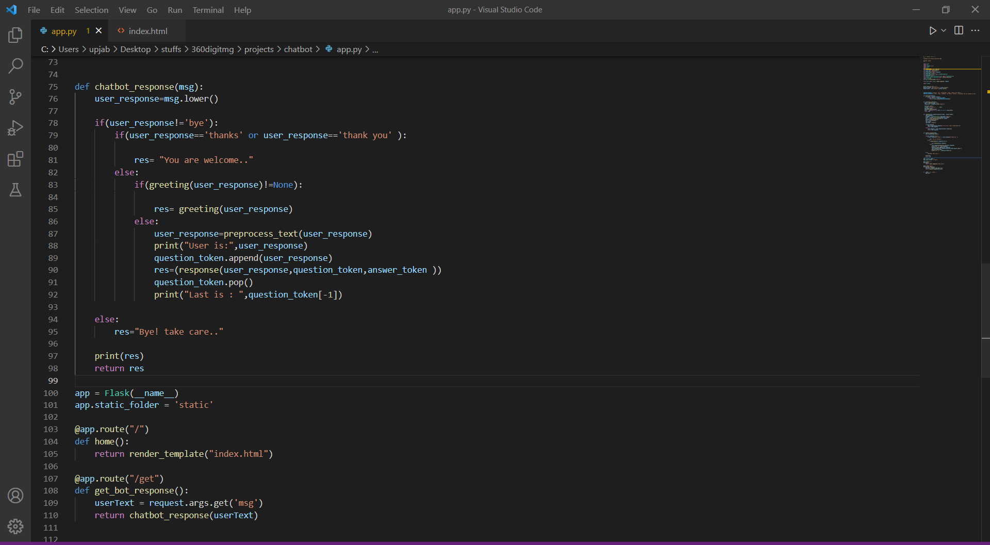
Model Deployment Code

Slide 19
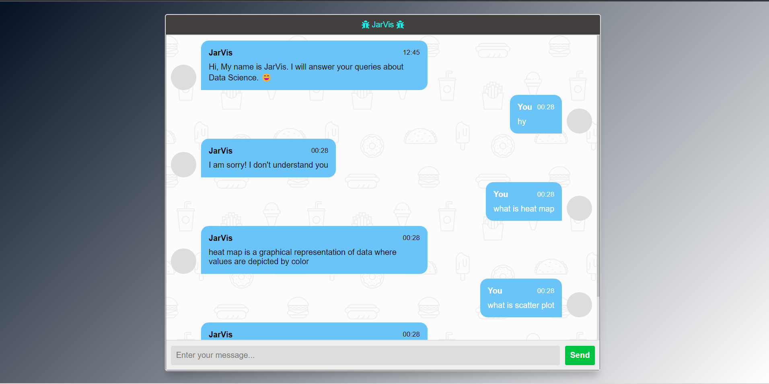
Output of the Deployed Model

Slide 20
Conclusion
In this Python data science project, we understood about chatbots and implemented a Machine learning version of a chatbot in Python which is accurate.
We can customize the data according to business requirements and train the chatbot with great accuracy.
Chatbots or smart assistants with artificial intelligence are dramatically changing businesses.
Chatbots can reach out to a large audience on messaging apps and be more effective than humans. They may develop into a capable information-gathering tool in the near future.

Slide 21
Future Scope
Future of marketing.
A conversation for everyone.
These conversation-driven bot building is the second big change in the chatbot landscape.
Final big change in chatbots will be much more granular personalization.

Slide 22


Slide 23


